Slide 1
Electromagnetic Compatibility
By
Prof. Dr. Mousa A. Abd-Allah

Slide 2
Electromagnetic Compatibility (EMC)
The ability of the system to operate in its intended environment without:
(a) suffering unacceptable degradation in performance due to coupling from other systems or
(b) causing unacceptable degradation in the performance of other systems via coupling.

Slide 3
Electromagnetic Interference (EMI)
Undesirable signals coupled from one system (emitter) to another (receptor) which degrade the performance of the receptor.
The emitter-receptor systems in an EMI problem are sometimes referred to as the threat-victim systems.

Slide 4
Emitter-Path-Receptor EMC Model

Slide 5
The three components of the emitter-path-receptor EMC model suggest that the effects of EMI can be reduced by:
(1) suppressing emissions,
(2) reducing the efficiency of the coupling path, or
(3) reducing the susceptibility of the receptor

Slide 6
Coupling Path
Conductive
radiative
Inductive
Capacitive
Conductive coupling as power cords, ground returns, interference cables, cases, etc
Electromagnetic coupling, the field from emitter decays as 1/R
Magnetic coupling where magnetic field is dominant
Electric coupling where electric field is dominant

Slide 7
Coupling Mechanism
Conduction
radiation
Radiative
Inductive
capacitive

Slide 8
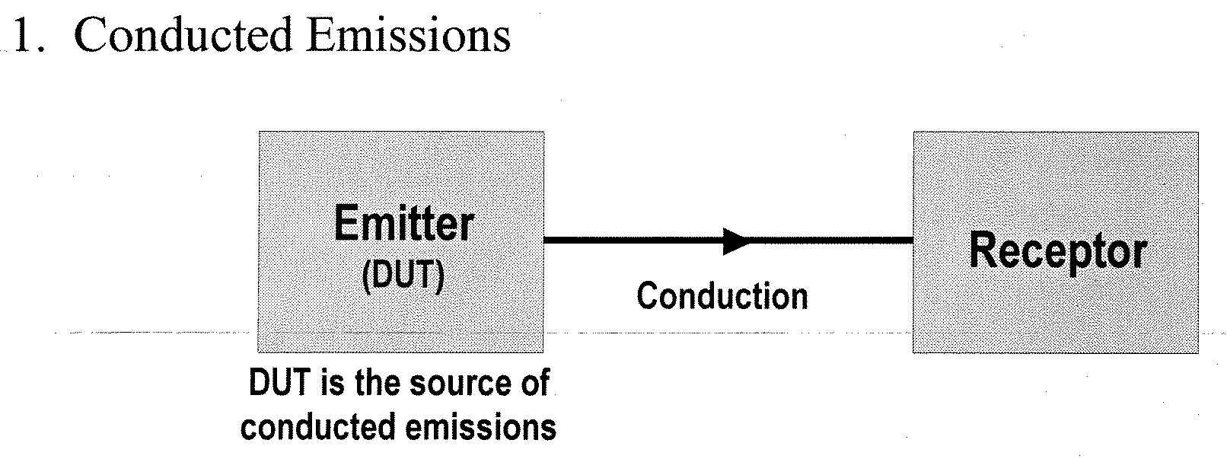

Slide 9
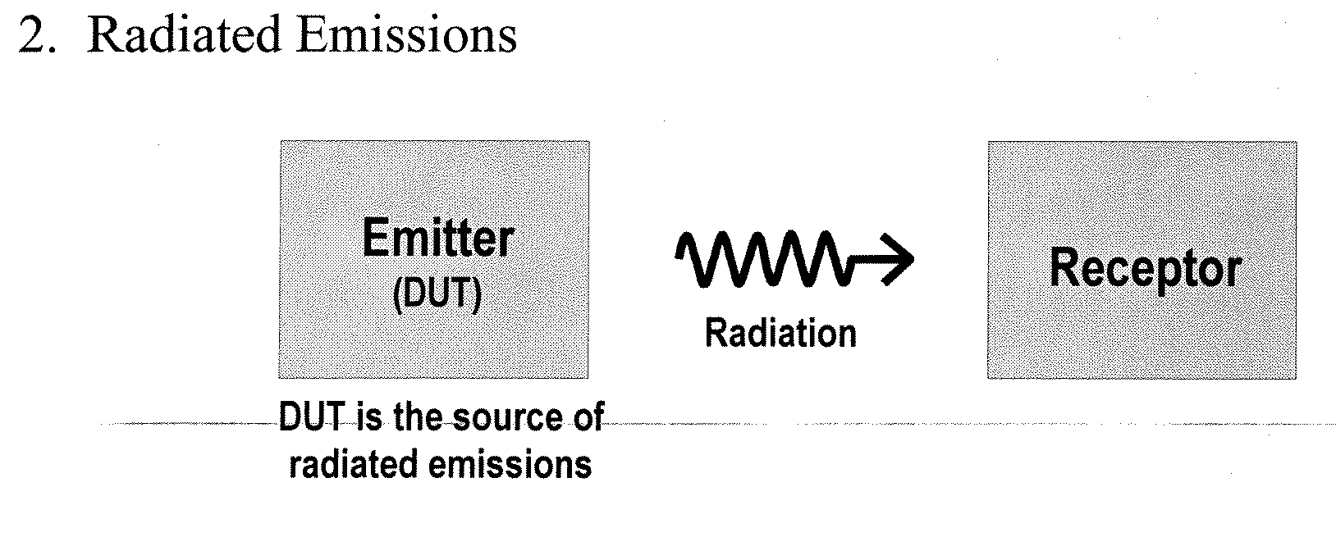

Slide 10
